Slide 1


Brannel Challenge Week
July 2026

Slide 2
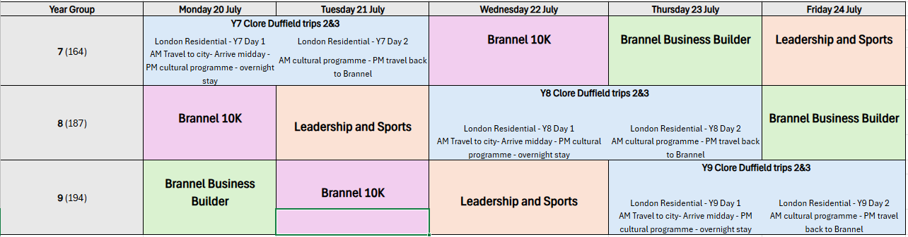

Slide 3

Brannel 10K

Slide 4
Brannel 10K
Day sack
Packed lunch
Water bottle
Suncream
Hat
Sensible footwear for walking 10k
Walking clothes / PE kit
Waterproofs if raining

Slide 5

Brannel Business Builder

Slide 6
Brannel Business Builder
Comfortable and sensible clothing
Normal lunch arrangements

Slide 7

Brannel Leadership and Sports

Slide 8
Brannel Leadership and Sports
PE kit
Trainers
Normal lunch arrangements

Slide 9
Brannel Explores London

Slide 10
Why London?
Develop confidence and independence
Experience learning beyond the classroom
Explore world-famous museums and galleries
Experience Britain's capital city
Build friendships and create lasting memories
Inspire future aspirations

Slide 11
Itinerary
Year 7
Year 8
Year 9
Monday 20th July
to
Tuesday 21st July
Wednesday 22nd July
to
Thursday 23rd July
Thursday 23rd July
to
Friday 24th July

Slide 12
Year 7
Year 8 & 9
Day 1
  Travel to London
  British Museum
  Regents Park
  Overnight stay at YHA London Central
Day 2
  Walking tour of London
  Chinatown
  Trafalgar Square
  National Gallery
  Buckingham Palace
  Parliament Square
  Whitehall & Horse Guards
  Return to Brannel
Day 1
  Travel to London
  Westminster Bridge
  Jubilee Gardens
  Tate Modern
  Thames Walk
  Overnight stay at YHA London Thameside
  Evening sightseeing tour
Day 2
  Natural History Museum
  Science Museum
  Victoria & Albert Museum
  Return to Brannel

Slide 13
Travel Arrangements
Departure
  Students to arrive at Brannel for 0615.
  Coaches depart Brannel at 0630
Return
  Arrive back at Brannel at approximately 2030

Slide 14
Food Arrangements
Included:
Evening meal
Breakfast
2nd Day Packed lunch
Students should bring money for:
Refreshments during travel
Service station stop on return journey
Students should also bring a packed lunch for the journey to London and a refillable water bottle

Slide 15
Behaviour Expectations
Students are ambassadors for Brannel School.
Staff ratio is 1:10
We expect:
  Respectful behaviour
  Positive attitudes
  Following staff instructions
  Staying with allocated groups
  Respect for the public and venues visited
The same standards expected in school apply throughout the trip.

Slide 16
What Should Students Bring?
Pack light - its one night!
  Comfortable walking shoes/trainers
  Change for toilets – 50P / £1 coins
  Waterproof coat/poncho
  Rucksack for walking
  Pyjamas
  Underwear
  Toiletries
  Prescribed medications (if required) – Please let staff know if your child is taking any with them
  Spending money (optional)
  Sensible clothing for all weathers (Brannel London T-Shirts)
  Suncream
  Hat
  Activity/Game for the journey
Brannel School cannot accept responsibility for loss or damage.
Students should avoid bringing expensive valuables.

Slide 17
Mobile Phones
Mobile phones are allowed to be used throughout the journey and during the day.
When students are in their hotel rooms, mobile phones will need to be handed in to staff. This is to safeguard all young people. Should any students need to contact parents, staff will facilitate this.
Mobiles will be handed back at breakfast the following day.

Slide 18
Trip Mobile Numbers
07940598524 – Mr Harris
07940598526 – Miss Moore
07940598522 – Mr Read
01726 822485 – from 0800 - 1600

Slide 19
FAQs
Will students be supervised at all times?
Yes.
What if my child becomes unwell?
Staff will provide first aid and contact parents if required.
Will students be walking a lot?
Yes! Comfortable footwear is essential.
How will parents be contacted in an emergency?
Staff will carry emergency contact information and school contact procedures will be followed.
What if my child gets lost?
All students will be wearing Brannel Wristbands with contact details on for key members of staff.

Slide 20
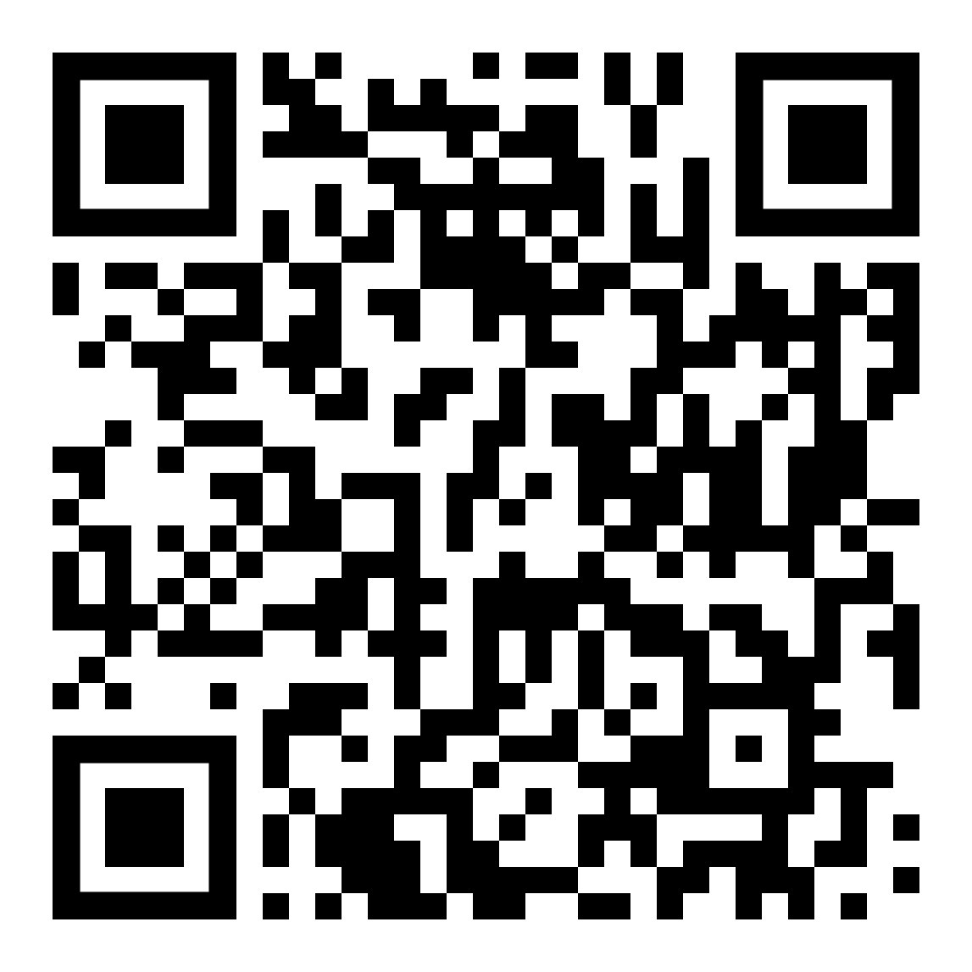

Year 7
Consent
Meal Choices

Slide 21

Year 8
Consent
Meal Choices

Slide 22

Year 9
Consent
Meal Choices

